Slide 1

WEB TECHNOLOGY 1
UE18CS204

Slide 2

Syllabus & Sharing
Syllabus
Click here for syllabus
Communication Medium

Slide 3

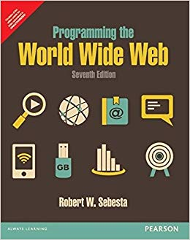

Textbooks

Slide 4

Web Technologies

Slide 5





Scope of WT-1 @ PESU

Slide 6

Internet Growth Trends
1977: 111 hosts on Internet
1981: 213 hosts
1983: 562 hosts
1984: 1,000 hosts
1986: 5,000 hosts
1987: 10,000 hosts
1989: 100,000 hosts
1992: 1,000,000 hosts
2001: 150 – 175 million hosts
2002: over 200 million hosts
By 2010, about 80% of the planet will be on the Internet

Slide 7
How Does the Web work?
The secret behind the google homepage appearing in your browser window

Slide 8
WEB BROWSERS

Slide 9
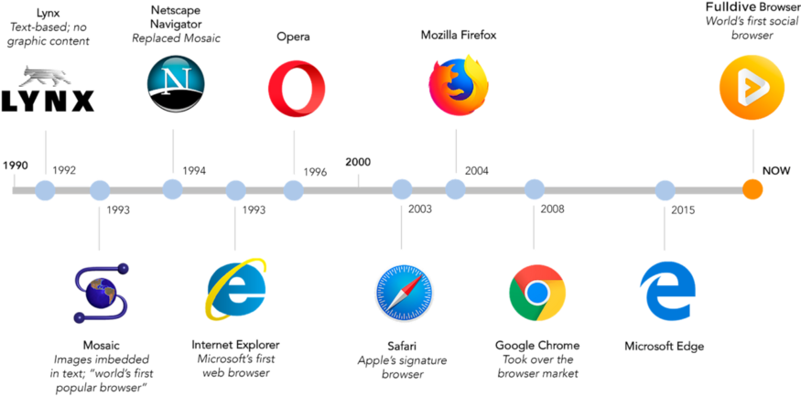
History of Web Browsers

Slide 10
History of Web Browsers
1990-w3c-Tim Berners Lee
1992-Lynx-Text based Browser
1993-Mosaic
1994-Improvement to mosaic came netscape navigator
1995-Internet Explorer
1996-opera
2003-Apples safari browser
2004 – mozilla launched firefox
2007-mobile safari
2008-Google chrome
2011-opera mini –mobile browser
2015-Microsoft Edge was born to combat google.
Now-Full dive browser

Slide 11
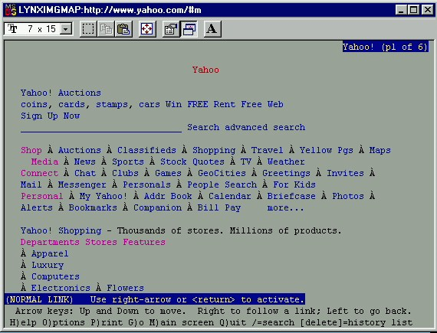
Lynx – A text based browser

Slide 12
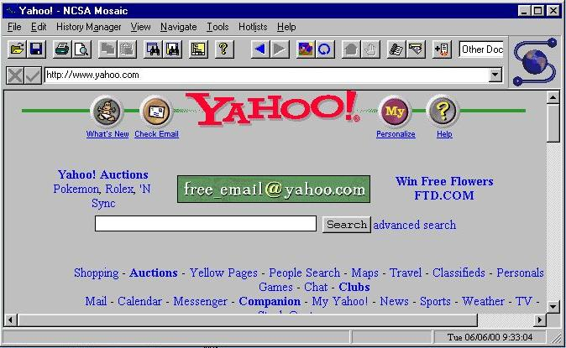
Mosaic – the first graphical browser

Slide 13
URLs
General form:
scheme:object-address
The scheme is often a communications protocol, such as telnet or ftp
For the http protocol, the object-address is: fully qualified domain name/doc path

Slide 14
Servers
Web Servers
Apache
IIS
General Web Server Characteristics
Web servers have two main directories:
Document root (servable documents)
Server root (server system software)
Document root is accessed indirectly by clients
Its actual location is set by the server configuration file
Requests are mapped to the actual location

Slide 15
Understanding Domain Names

Slide 16
DNS
DNS – Domain Name System
DNS is what translates your familiar domain name (www.google.com) into an IP address your browser can use (173.194.33.174).
Before the page and any resource on the page is loaded, the DNS must be resolved so the browser can establish a TCP connection to make the HTTP request.
The DNS Resolution process starts when the user types a URL address on the browser and hits Enter.

Slide 17
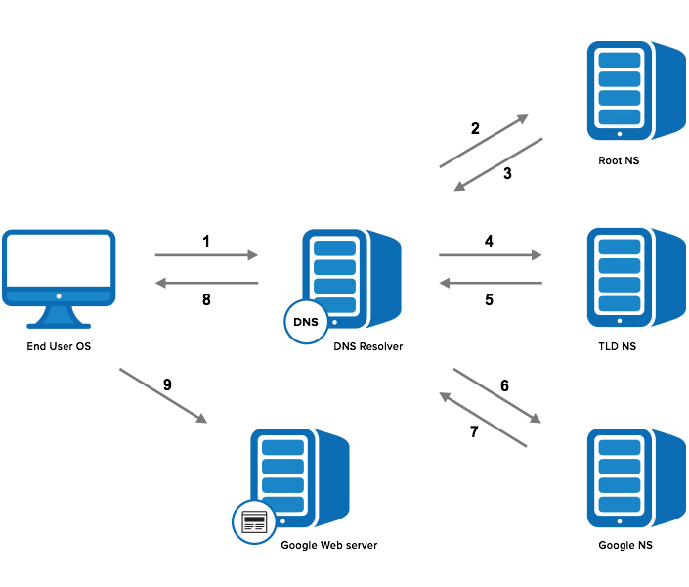
DOMAIN NAME RESOLUTION

Slide 18
Domain Name Resolution
Step 1: OS Recursive Query to DNS Resolver
Step 2: DNS Resolver Iterative Query to the Root Server
Step 3: Root Server Response
Step 4: DNS Resolver Iterative Query to the TLD Server
Step 5: TLD Server Response
Step 6: DNS Resolver Iterative Query to the Google.com NS
Step 7: Google.com NS Response
Step 8: DNS Resolver Response to OS
Step 9: Browser Starts TCP Handshake

Slide 19
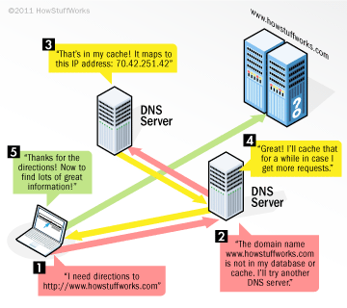
Example

Slide 20
How can you get your own website?

Slide 21
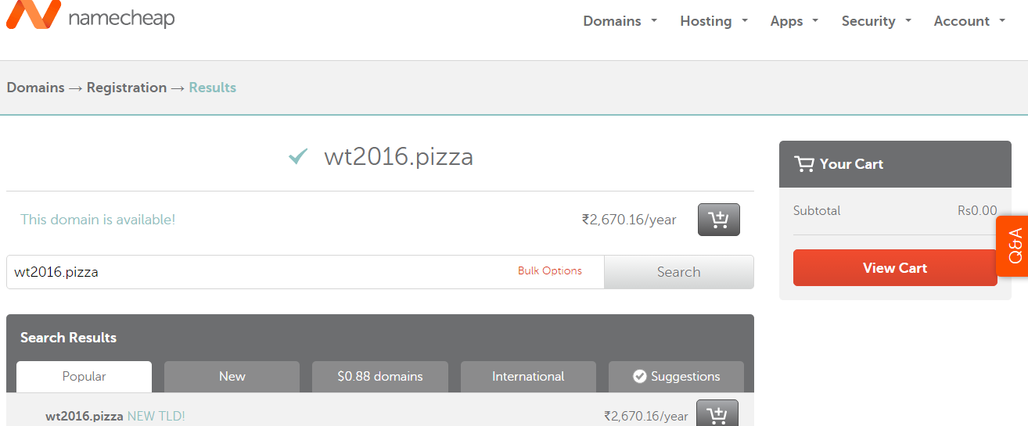
Getting a domain name….

Slide 22
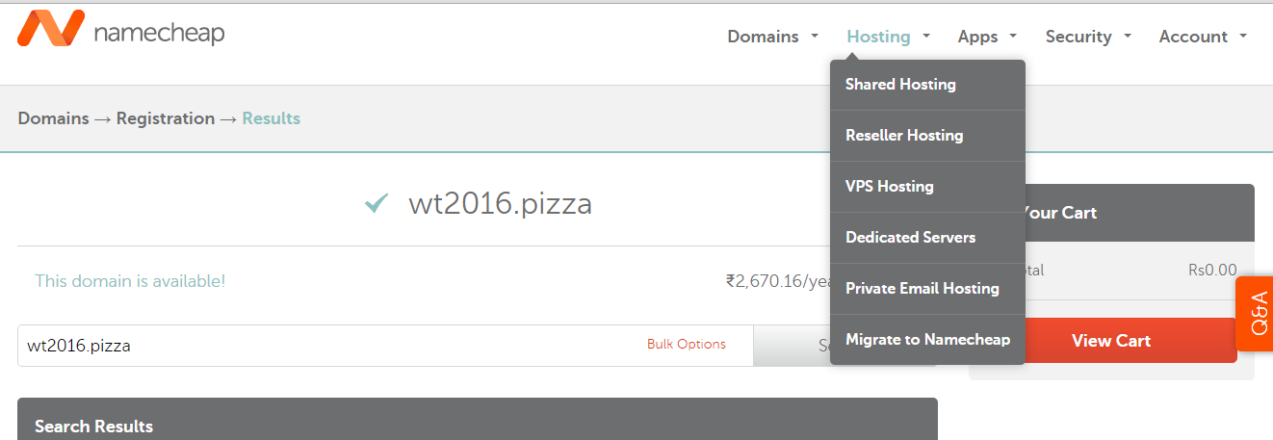
Web Hosting

Slide 23


Slide 24
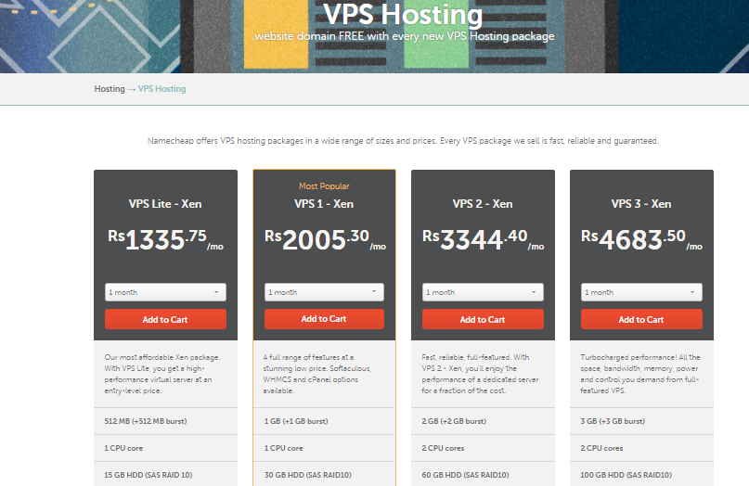

Slide 25
